Slide 1
A Sequential Codelet Model for parallel program Execution
Jose Manuel Monsalve Diaz
Notes:
A parallel machine model through hierarchical codelet definition

Slide 2
This presentation
Motivation
Brief History of Sequential Computing
Sequential computing infrastructure
Parallelism In current systems
Problem statement and goals
Sequential computation. Lessons learned
Parallel Turing Machine definition
Sequential Codelet Model
Single level SCM Abstract Machine
Exploiting parallelism in the SCM Abstract Machine
Hierarchical SCM Abstract Machine
Examples
Dot Product
1D Convolution

Slide 3
MOTIVATION

Slide 4
How did we get here?
Writable Control Store
Intel Tejas (Cancelled)
Intel 80386
IBM PC
Intel 8086
CDC6600
Hardware
Von Neumann Architecture
2004
Turing Machine
FORTRAN
1981
1985
Short Code
ISA (IBM 360)
1973
1979
1966
Large distance between hardware and software abstractions
1936
1945
1960
Unix
POSIX Threads
1949
1957
OpenMP 1.0
C
AIX OS
C++
MPI 1
1969
1972
Software
1983
1986
1991
1995
1998
Based on Hennessey and Patterson Turing Lecture:
A New Golden Age for Computer Architecture
Notes:
Add AIX IBM Operating System
MULTICS Virtual Memory
Add at the bottom of this slide: Cite the H&P Turing award paper
Two dimensional timeline

Slide 5
How did we get here?
Hardware
Von Neumann Architecture
Turing Machine
ISA (IBM 360)
All our General Purpose computation ecosystem is based off these three models which are purely sequential
1936
1945
1960
Software

Slide 6
computer Systems Infrastructure
U S E R S / P R O G R A M M E R S
PROGRAMMING ENVIRONMENTS
EXECUTION ENVIRONMENTS
HIGH LEVEL PROGRAMMING LANGUAGES
(C, C++, FORTRAN, JAVA)
SOFTWARE PACKAGES, LIBRARIES, UTILITIES
DYNAMIC LIBRARIES
LOADERS
RUNTIMES AND OS SCHEDULERS
COMPILERS
TOOLS & SDKs
HARDWARE PROGRAMMING API
H A R D W A R E
RUNTIME SYSTEM
HARDWARE
Notes:
There is a large discussion on how to fill in this gap

Slide 7
Parallelism in current systems
Software infrastructure
Explicit Parallelism (User defined)
Multiple Processes
MPI
Multiple Threads
OpenMP
SYCL
Higher level programming abstractions
Tensorflow
Parallel prog. models
Parallel abstraction model
Runtime Systems
Processes and Threads
ISA
Implemented Architecture
Implicit Parallelism (ILP)
Pipelining
Superscalar
Out of Order Execution
Register Renaming
Von Neuman Architecture
Turing Machine

Slide 8
Problem Statement
Based on the lessons learned from sequential computation, is it possible to define an implicitly parallel program execution model that extends through the whole computation system (not limited to a single core)?

Slide 9
Goals
Define a program execution model, with its respective abstract machine which:
Is easy to reason about for the programmer,
Uses the memory and system hierarchy
Allows parallelism
Allows heterogeneity
Enable us to use all the experience gather throughout the years in sequential computation
Correctness
Quantitative program execution analisys
Other properties of sequential execution…

Slide 10
SEQUENTIAL COMPUTATION Lessons learned

Slide 11
5 Stages Pipeline architecture
FETCH
DECODE
EXECUTE
MEMORY
WRITE BACK
Next PC
Next seq PC
Next seq PC
MUX
Adder
Reg File
Zero?
MUX
IF/ID
ID/EX
EX/MEM
MEM/WB
ALU
Memory
Inst
Memory
Sign Extend
MUX
MUX
ADDRESS

Slide 12
5 Stages Pipeline architecture
Scheduling Unit
L0 Register File
Memory Access Interface
Write Back
SYNC
FETCH
DECODE
ALU + FP
Inst Mem

Slide 13
ALU Operations
Supported operations are a tradeoff between:
Application
Chip Area
Feature size
Required on-chip memory
System cost
…
Scheduling Unit
L0 Register File
Memory Access Interface
Write Back
SYNC
FETCH
DECODE
ALU + FP
Inst Mem

Slide 14
ALU Operations
ALU Operations execution time are not dependent on the memory access time.
T_{compute} >> T_{memory}
Scheduling Unit
L0 Register File
Memory Access Interface
Write Back
SYNC
FETCH
DECODE
ALU + FP
Inst Mem

Slide 15
5 Stages Pipeline architecture
Scheduling Unit
L0 Register File
Memory Access Interface
Write Back
SYNC
FETCH
DECODE
Extending the EU
Inst Mem

Slide 16
Hierarchical Turing Machine

Slide 17
Hierarchical Turing Machine
Current state L_{N}
Executing State
LEVEL N
Level N Infinite tape memory
 | Ω | ℌ | ℥ | Ω | ℥
State machine (codelets)
S1
S2
READING HEAD
Each level is a complete Turing machine, with an additional state evaluation unit and an infinite memory tape.
The state evaluation unit is a complete Turing machine, that uses the infinite memory tape of the level above as its memory storage.
A state is defined in terms of a Finite state machine that is evaluated in the state evaluation unit of the level below
State evaluation unit
S3
S4
Ω
℥
Ω
℥
Level N-1 Infinite tape memory
Current state L_{N-1}
S3
LEVEL N-1
State machine (codelets)
READING HEAD
K1
K2
State evaluation unit
Ω
℥
Ω
℥
K3
Level N-2 Infinite tape memory
Current state L_{N-2}
K1
LEVEL N-2
…
…
Notes:
Petri Net Thesis. Allows the system on multiple states
Although the definition of a state and its transition is sequential in the sense that it will transition to only one single state to follow. However, it allows parallel execution in the hardware implementation.

Slide 18
Sequential Codelet Model

Slide 19
Sequential Codelet Model
Scheduling Unit
L1 Register File
L0 memory
Memory Access Interface
Write Back
SYNC
FETCH
DECODE
L1
L0
Arithmetic operations
Inst Mem
Scheduling Unit
L0 Register File
Memory Access Interface
Write Back
SYNC
FETCH
DECODE
L0
ALU + FP
Inst Mem

Slide 20
Codelet Definition
A Codelet is an instruction that is well defined in terms of resources.
Required memory
Inputs, Outputs and Operation
Computational complexity
Bounded execution latency
A Codelet is executed when all the required resources are available:
Data dependencies
Structural dependencies
A Codelet is executed atomically
A Codelet is non-preemptive
A Codelet is defined in terms of other codelets or lower level hardware instructions

Slide 21
Single Level SCM Abstract Machine

Slide 22
Abstract machine Sequential (single core)
MEMORY
L1 Sequentia Codelet Abstract Machine
SU
FETCH
DECODE
EXECUTE
(Current Architectures)
Write Back
Synchronize
Memory Interface
Reg File

Slide 23
Abstract machine Sequential (single core)
MEMORY
L1 Sequentia Codelet Abstract Machine
SU
FETCH
DECODE
EXECUTE
(Current Architectures)
Write Back
Synchronize
Memory Interface
Reg File

Slide 24
Abstract machine Parallelism – II (Superscalar)
MEMORY
L1 Sequentia Codelet Abstract Machine
Current core Architecture
(EXECUTE)
Current core Architecture
(EXECUTE)
Write Back
Synchronize
SU
FETCH
DECODE
EXECUTE
(Current Architectures)
Memory Interface
Reg File

Slide 25
Abstract machine Heterogenity
GPU-Like core
CPU-like core
CSA-Like core
MEMORY
L1 Sequentia Codelet Abstract Machine
Current core Architecture
(EXECUTE)
Current core Architecture
(EXECUTE)
Write Back
Synchronize
SU
FETCH
DECODE
EXECUTE
(Current Architectures)
Memory Interface
Reg File

Slide 26
Abstract machine Parallelism – III (Out-of-order execution)
MEMORY
L1 Sequentia Codelet Abstract Machine
Current core Architecture
(EXECUTE)
Current core Architecture
(EXECUTE)
Write Back
Synchronize
Re-ordering
SU
FETCH / DECODE
Reordering buffer
EXECUTE
(Current Architectures)
Memory Interface
Reg File

Slide 27
Abstract machine Parallelism – IV (Register renaming)
MEMORY
L1 Sequentia Codelet Abstract Machine
Current core Architecture
(EXECUTE)
Current core Architecture
(EXECUTE)
Write Back
Synchronize
Renaming
SU
FETCH / DECODE
Renaming
EXECUTE
(Current Architectures)
Memory Interface
Reg File

Slide 28
Abstract machine Parallelism – V (SIMD)
MEMORY
L1 Sequentia Codelet Abstract Machine
Current core Architecture
(EXECUTE)
Current core Architecture
(EXECUTE)
Write Back
Synchronize
Renaming
SU
FETCH / DECODE
Renaming
VECTOR EXECUTION
(Current Architectures)
Memory Interface
Reg File

Slide 29
Abstract machine A parallel program
It can be expressed sequentially as an ISA:
LD R1 ADDR1
LD R2 ADDR2
OP1 R3 R1 R2
OP2 R3 R4
OP2 R3 R5
OP3 R3 R6
OP3 R3 R7
LD
LD
OP1
OP2
OP2
OP3
OP3

Slide 30
Hierarchical SCM Abstract Machine

Slide 31
Deepening the hierarchy Can we go an extra level?
MEMORY

Slide 32
Deepening the hierarchy Can we go an extra level?
Current core Architecture
(EXECUTE)
Current core Architecture
(EXECUTE)
Write Back
Synchronize
Renaming
SU
FETCH / DECODE
Renaming
EXECUTE
(L1 CSM)
MEMORY
MEMORY
Memory Interface
Reg File
L1 Sequentia Codelet Abstract Machine

Slide 33
Hierarchical SCM Abstract Machine
To higher levels
To higher level mem
Scheduling Unit
L2 Register File
L1 memory
Memory Access Interface
Write Back
SYNC
FETCH
DECODE
L2
L1
Higher level operations
Inst Mem
A program is defined hierarchically, mapping to each level of the SCM Abstract Machine
Each level behaves as an ISA that maps to execution units in the level below.
Memory operations LD/ST are issued to the level above, guaranteeing low latency
Memory allocation at a certain level is done through register allocation
Scheduling Unit
L1 Register File
L0 memory
Memory Access Interface
Write Back
SYNC
FETCH
DECODE
L1
L0
Arithmetic operations
Inst Mem
Scheduling Unit
L0 Register File
Memory Access Interface
Write Back
SYNC
FETCH
DECODE
L0
ALU + FP
Inst Mem

Slide 34
Codelet Definition Revisited
A Codelet is an instruction that is well defined in terms of resources.
A Codelet is executed when all the required resources are available:
A Codelet is executed atomically
A Codelet is non-preemptive
A Codelet is defined in terms of other codelets or lower level hardware instructions
A Codelet is mapped to a level of the hierarchy defined by the Sequential Codelet Model

Slide 35
Examples

Slide 36
A Dot Product Example

Slide 37
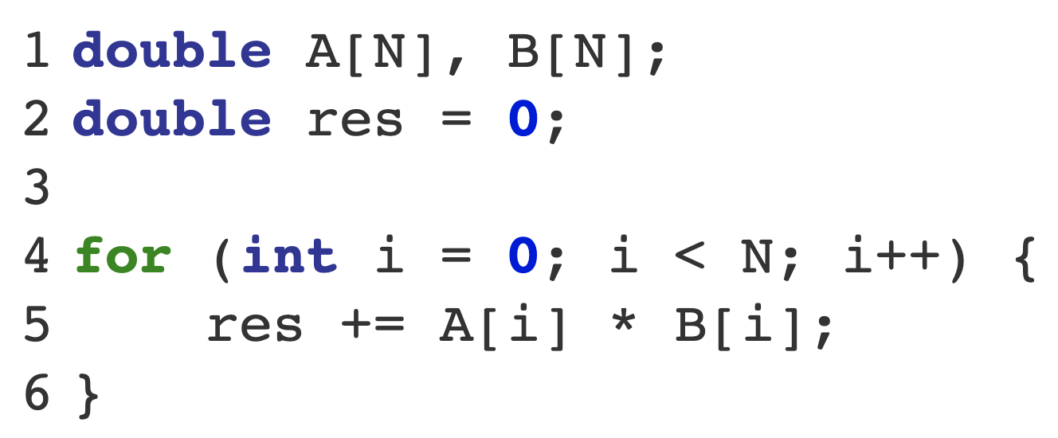
Dot Product
.
A
B
=

Slide 38
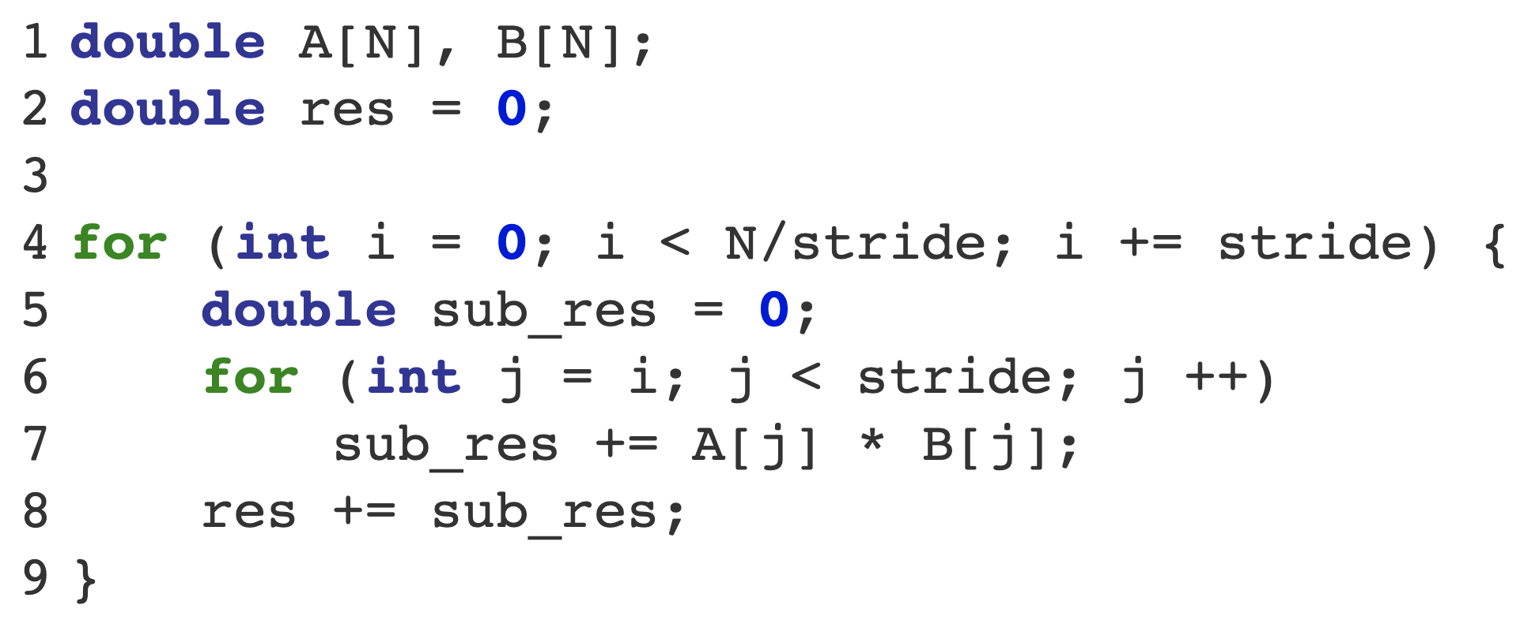
Dot Product
.
A
B
=

Slide 39
Dot Product
.
A
B
=
Codelet

Slide 40
Dot Product
.
A
B
=
subA
subB
subDotCod
movaps xmm0, [basePtr1]
movaps xmm1, [basePtr2]
DPPS xmm0, xmm1, 0xF
Movaps [basePtr3], xmm0
L0 Codelet definition
Using SSE SIMD ISA
Sub_res

Slide 41

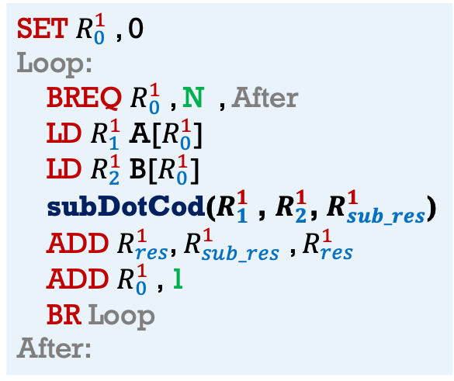
Dot Product
.
A
subDotCod
B
L0 codelet
=
$$R_{0}^{1}$$
SET $R_{0}^{1}$ , 0
Loop:
BREQ $R_{0}^{1}$ , N , After
LD $R_{1}^{1}$ A[$R_{0}^{1}$]
LD $R_{2}^{1}$ B[$R_{0}^{1}$]
subDotCod($R_{1}^{1}$ , $R_{2}^{1}$, $R_{sub_res}^{1}$)
ADD $R_{res}^{1}$, $R_{sub_res}^{1}$ , $R_{res}^{1}$
ADD $R_{0}^{1}$ , 1
BR Loop
After:
Level in hierarchy
Register name at current level
L1 Codelet definition

Slide 42
A convolution example

Slide 43
1D Convolution
int A[1000], window[10], res[1009];
for (int i = 0; i < 1009; i ++) { // Iterate over res
int val = 0;
for (int j = 9; j >= 0; j --) { // iterate over A
if ( i - 9 + j >= 0 && j - 9 + j <1000)
val + = A[i - 9 + j]*window[j];
}
res[i] = val;
}

Slide 44
1D Convolution
int A[1000], window[10], res[1009];
for (int i = 0; i < 1009; i ++) { // Iterate over res
int val = 0;
for (int j = 9; j >= 0; j --) { // iterate over A
if ( i - 9 + j >= 0 && j - 9 + j <1000)
val + = A[i - 9 + j]*window[j];
}
res[i] = val;
}
window
A
res
0
1009
int A[1000], window[10], res[1009];
for (int i = 0; i < 1009; i ++) { // Iterate over res
int val = 0;
for (int j = 9; j >= 0; j --) { // iterate over A
if ( i - 9 + j >= 0 && j - 9 + j <1000)
val + = A[i - 9 + j]*window[j];
}
res[i] = val;

Slide 45
1D Convolution
res = A * window
window
A
res
window
A
res

Slide 46
1D Convolution
int A[1000], window[10], res[1009];
for (int i = 0; i < 1009; i ++) { // Iterate over res
int val = 0;
for (int j = 9; j >= 0; j --) { // iterate over A
if ( i - 9 + j >= 0 && j - 9 + j <1000)
val + = A[i - 9 + j]*window[j];
}
res[i] = val;
}

Slide 47
1D Convolution – tiled
// L1
ptrA_1 = A;
ptrRes_1 = res;
ptrWin_1 = win;
for (int ii = 0; ii < 1009; ii +=100) {
int end = (ii + 100 < 1009 ? 100 : 1009%100);
for (int i = 0; i < end; i ++) {
int val = 0;
// L0
ptrRes_0 = ptrRes_1 + i;
for (int j = 9; j >= 0; j --) {
if ( i - 9 + j >= 0 && j - 9 + j < end) {
ptrWin_0 = ptrWin_1 + j;
ptrA_0 = ptrA_1 + (i - 9 + j);
val + = *ptrA_0 + *ptrWin_0;
}
ptrRes_0 = val;
}
ptrRes_1 += 100;
ptrA_1 += 100;
}
// L2
int A[1000], window[10], res[1009];
int *ptrA_1;
int *ptrA_0;
int *ptrRes_1;
int *ptrRes_0;
int *ptrWin_1;
int *ptrWin_0;

Slide 48
1D Convolution Pseudo-code
// L2
int A[1000], window[10], res[1009];
conv_1D(A, window, res, 1009);
// L1
codelet_def conv_1D (int *A, int *Window, int* res, int sizeRes) {
int *ptrA_1;
int *ptrRes_1;
int *ptrWin_1;
ptrA_1 = A;
ptrRes_1 = res;
ptrWin_1 = win;
for (int ii = 0; ii < sizeRes; ii +=100) {
int end = (ii + 100 < sizeRes ? 100 : sizeRes%100);
for (int i = 0; i < end; i ++) {
int val = 0;
single_conv(ptrA_1, ptrWin_1, &val, i, end)
ptrRes_0 = val;
ptrRes_0++;
}
ptrA_1 += 100;
}
}
// L0
codelet_def single_conv( int* ptrA_1, int* ptrWin_1, int* val, int i, int end) {
int *ptrA_0;
int *ptrWin_0;
for (int j = 9; j >= 0; j --) {
if ( i - 9 + j >= 0 && i - 9 + j < end) {
ptrWin_0 = ptrWin_1 + j;
ptrA_0 = ptrA_1 + (i - 9 + j);
val + = *ptrA_0 + *ptrWin_0;
}
}

Slide 49
1D Convolution Pseudo-code L2
// L2
int A[1000], window[10], res[1009];
conv_1D(A, window, res, 1009);

Slide 50
1D Convolution Pseudo-code L1
// L1
codelet_def conv_1D (int *A, int *Window, int* res, int sizeRes) {
int *ptrA_1;
int *ptrRes_1;
int *ptrWin_1;
ptrA_1 = A;
ptrRes_1 = res;
ptrWin_1 = win;
for (int ii = 0; ii < sizeRes; ii +=100) {
int end = (ii + 100 < sizeRes ? 100 : sizeRes%100);
for (int i = 0; i < end; i ++) {
int val = 0;
single_conv(ptrA_1, ptrWin_1, &val, i, end)
ptrRes_0 = val;
ptrRes_0++;
}
ptrA_1 += 100;
}
}

Slide 51
1D Convolution Pseudo-code L0
// L0
codelet_def single_conv( int* ptrA_1, int* ptrWin_1, int* val, int i, int end) {
int *ptrA_0;
int *ptrWin_0;
for (int j = 9; j >= 0; j --) {
if ( i - 9 + j >= 0 && i - 9 + j < end) {
ptrWin_0 = ptrWin_1 + j;
ptrA_0 = ptrA_1 + (i - 9 + j);
val + = *ptrA_0 + *ptrWin_0;
}
}

Slide 52
To higher levels
To higher level mem
Scheduling Unit
L2 Register File
L1 memory
Memory Access Interface
Write Back
SYNC
FETCH
DECODE
// L2
int A[1000], window[10], res[1009];
conv_1D(A, window, res, 1009);
L2
L1
Higher level operations
L2 Inst Mem
// L1
codelet_def conv_1D (int *A, int *Window, int* res, int sizeRes) {
int *ptrA_1;
int *ptrRes_1;
int *ptrWin_1;
ptrA_1 = A;
ptrRes_1 = res;
ptrWin_1 = win;
for (int ii = 0; ii < sizeRes; ii +=100) {
int end = (ii + 100 < sizeRes ? 100 : sizeRes%100);
for (int i = 0; i < end; i ++) {
int val = 0;
single_conv(ptrA_1, ptrWin_1, &val, i, end)
ptrRes_0 = val;
ptrRes_0++;
}
ptrA_1 += 100;
}
}
Scheduling Unit
L1 Register File
L0 memory
Memory Access Interface
Write Back
SYNC
FETCH
DECODE
L1
L0
Arithmetic operations
L2 Inst Mem
Scheduling Unit
L0 Register File
Memory Access Interface
Write Back
SYNC
// L0
codelet_def single_conv( int* ptrA_1, int* ptrWin_1, int* val, int i, int end) {
int *ptrA_0;
int *ptrWin_0;
for (int j = 9; j >= 0; j --) {
if ( i - 9 + j >= 0 && i - 9 + j < end) {
ptrWin_0 = ptrWin_1 + j;
ptrA_0 = ptrA_1 + (i - 9 + j);
val + = *ptrA_0 + *ptrWin_0;
}
}
FETCH
DECODE
L0
ALU + FP
L2 Inst Mem

Slide 53
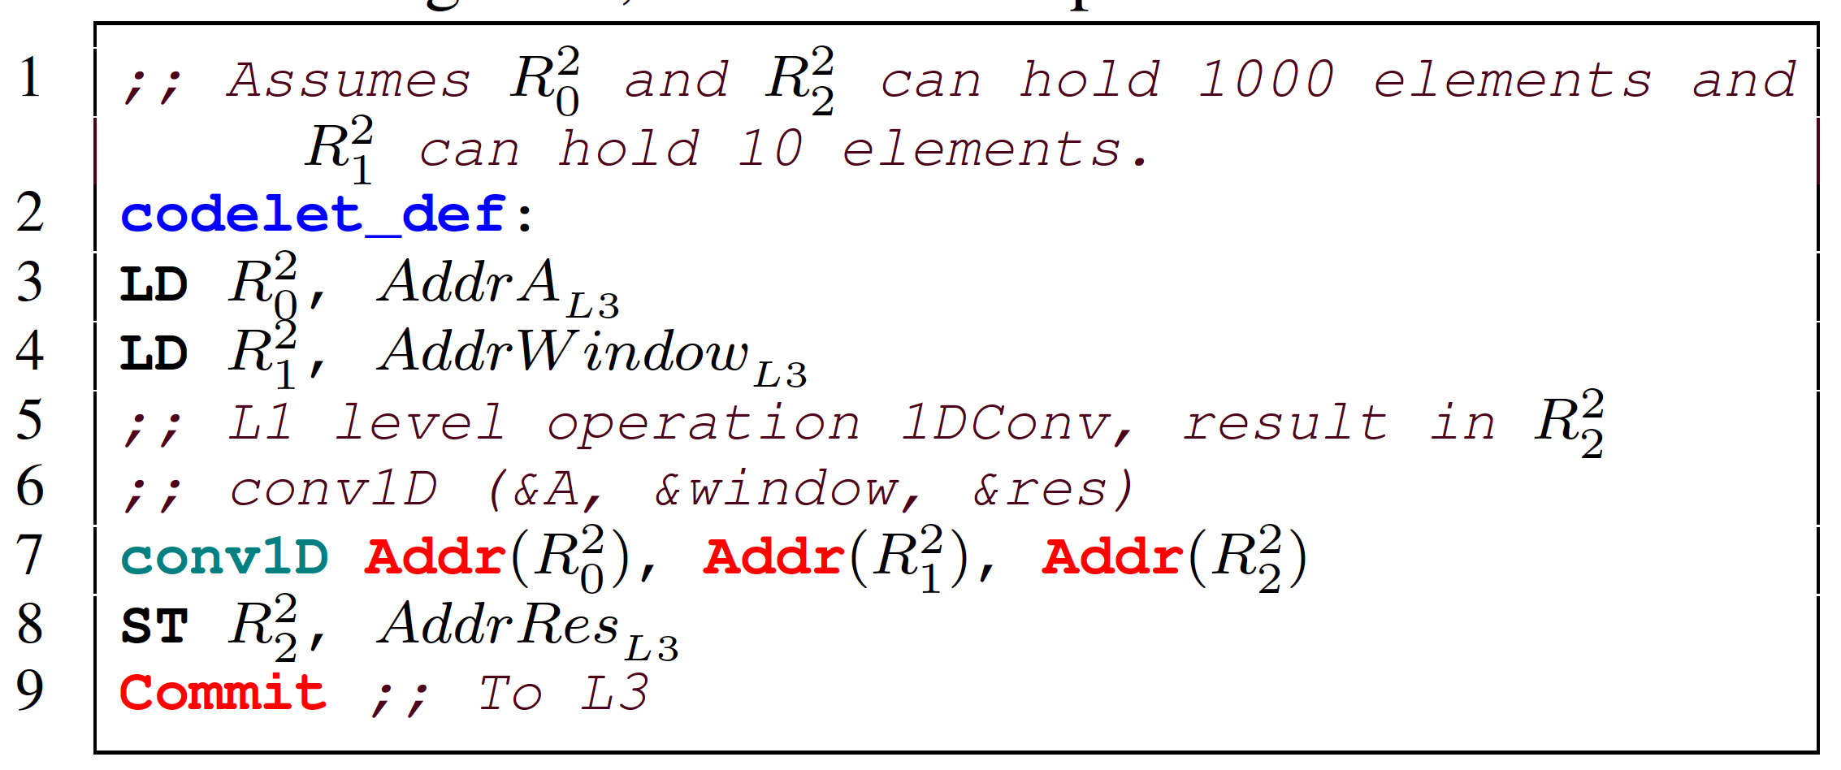
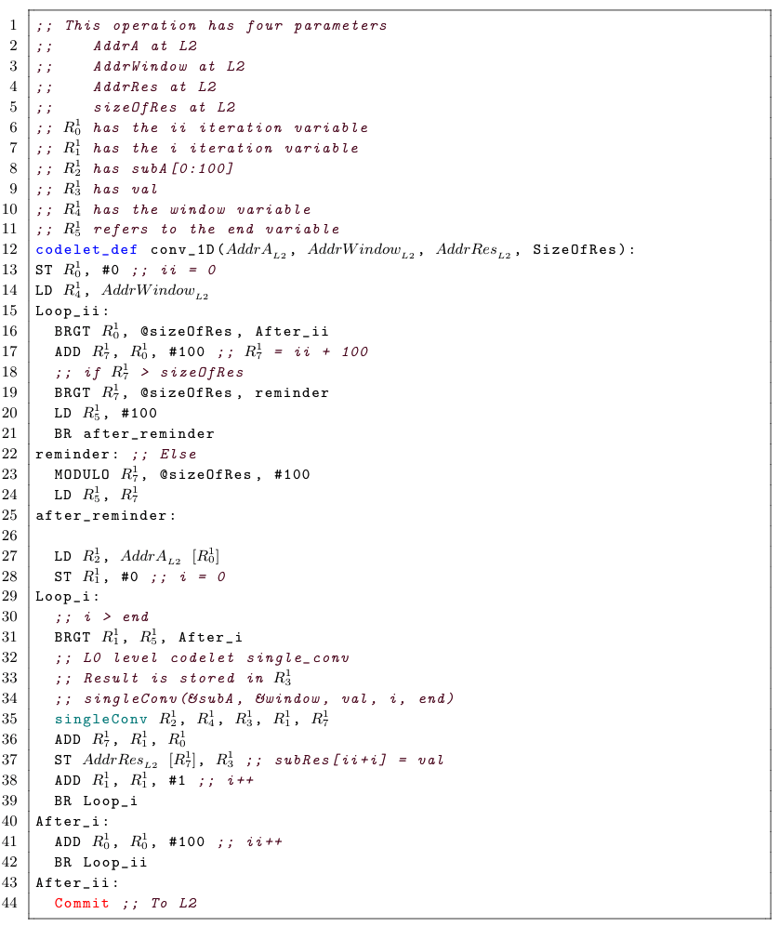
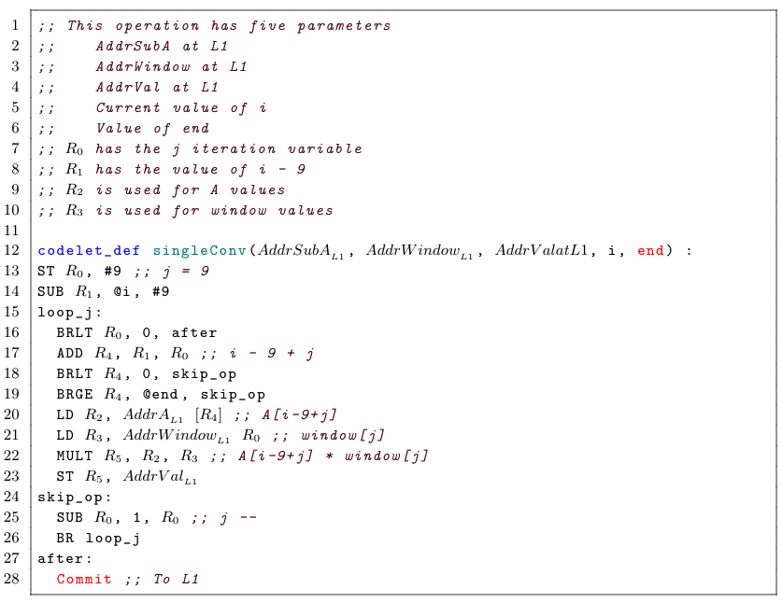
To higher levels
To higher level mem
Scheduling Unit
L2 Register File
L1 memory
Memory Access Interface
Write Back
SYNC
FETCH
DECODE
L2
L1
Higher level operations
L2 Inst Mem
Scheduling Unit
L1 Register File
L0 memory
Memory Access Interface
Write Back
SYNC
FETCH
DECODE
L1
L0
Arithmetic operations
L2 Inst Mem
Scheduling Unit
L0 Register File
Memory Access Interface
Write Back
SYNC
FETCH
DECODE
L0
ALU + FP
L2 Inst Mem

Slide 54
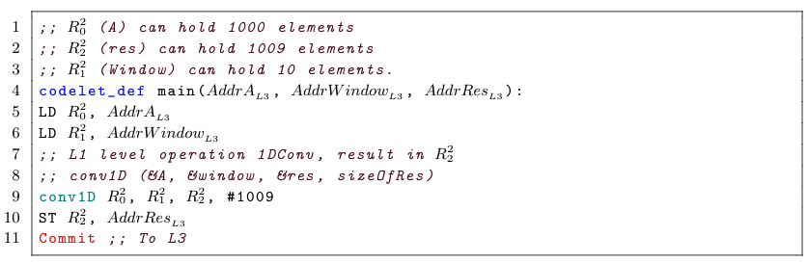
L2 Codelet ISA description

Slide 55
L1 Codelet ISA description

Slide 56
L0 Codelet ISA description

Slide 57
To higher levels
To higher level mem
Scheduling Unit
L2 Register File
L1 memory
Memory Access Interface
Write Back
SYNC
FETCH
DECODE
L2
L1
Higher level operations
L2 Inst Mem
Scheduling Unit
L1 Register File
L0 memory
Memory Access Interface
Write Back
SYNC
FETCH
DECODE
L1
L0
Arithmetic operations
L2 Inst Mem
Scheduling Unit
L0 Register File
Memory Access Interface
Write Back
SYNC
FETCH
DECODE
L0
ALU + FP
L2 Inst Mem

